Slide 1
NVIDIA Strategy Pitch: Scaling Beyond the Chip
By: Darren, Mohamad, and Mike
B BUS 470

Slide 2
01
The Problem

Slide 3
What problem are we solving?
NVIDIA leads in GPUs and AI chips—but competitors like Amazon, Meta, and Microsoft are developing their own chips.
This reduces long-term dependence on NVIDIA’s hardware.
Hardware alone may not sustain market leadership.

Slide 4
02
Problem Definition

Slide 5
Strategic Decision
Should NVIDIA continue to compete through GPU and chip innovation alone?
Or evolve into a full-stack AI platform company that integrates software, services, and ecosystem tools?

Slide 6
03
Profit Tree

Slide 7
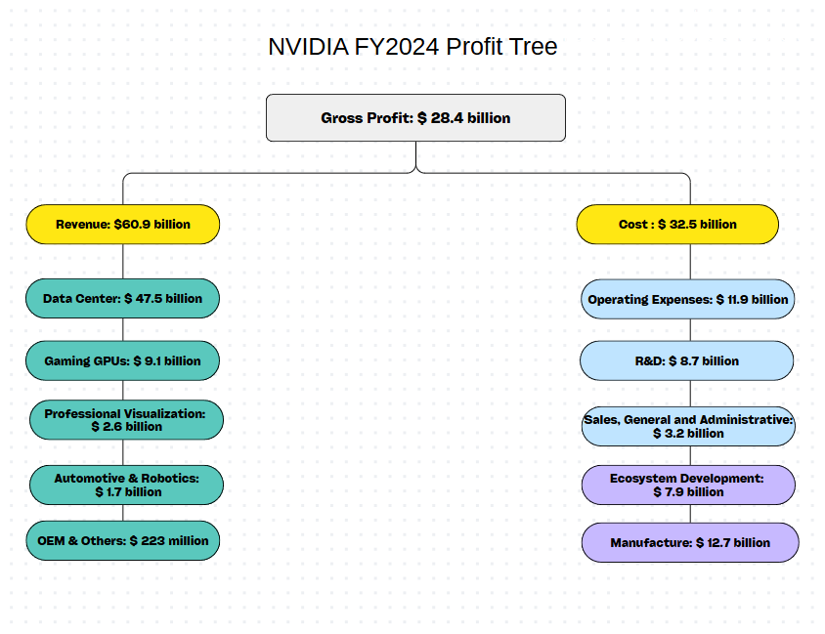
Profit Tree

Slide 8
04
NVIDIA’s Strategy

Slide 9
Strategy
Goal: Lead the future of AI, computing, and graphics Scope: Global platform serving gaming, data centers, robotics, automotive, and more Advantage: World-class chips, proprietary software (CUDA, Omniverse), strong brand trust

Slide 10
05
Hypothesis

Slide 11
Hypothesis and Rationale
NVIDIA’s long-term advantage lies in evolving into a platform company, not just a chipmaker.

Slide 12
06
Analysis Summary

Slide 13
PARC Framework
People | Top-tier engineers, cross-functional collaboration
Architecture | Agile teams, fast product pivoting
Routine | Predictable innovation, Omniverse feedback loops
Culture | Visionary, fail-fast, long-term bets

Slide 14
Competency Traps
Overreliance on GPU hardware
Overconfidence in current AI leadership

Slide 15
07
Recommendations

Slide 16
Recommendations
1. Scale Software & Services
Monetize CUDA and Omniverse through subscriptions and enterprise SaaS
Provide developer tools and training
Create sticky platforms for recurring revenue
2. Diversify Beyond GPUs
Invest in robotics, quantum computing, automotive chips

Slide 17
Thanks!

